Slide 1
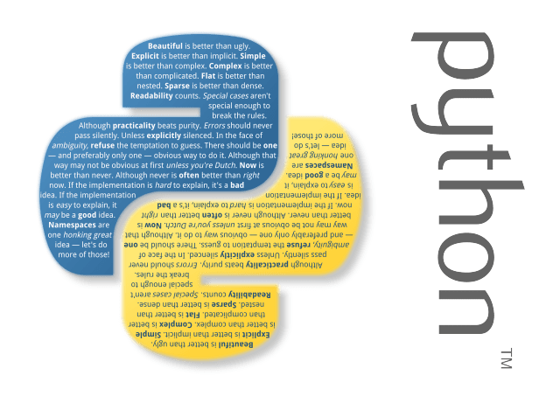

PYTHON FINAL PROJECT:
PROJECT NAME : SNAKE GAME

Slide 2
GROUP MEMBERS NAME:
NAME: SYEDA MANAHIL MAJID
STUDENT ID: ECP-F-94739
NAME: ADEEN WAQAR
STUDENT ID: ECP-F-66234
NAME: WAREESHA
STUDENT ID:

Slide 3
GROUP LEADER:
“We all three group leaders because we three have done equal work in this project.”

Slide 4
PROJECT DETAILS:
Snake can move in a given direction and when it eats the food, the length of snake increases. When the snake crosses itself, the game will be over.
In this game, the main objective of the player is to catch the maximum number of fruits without hitting the wall or itself.

Slide 5
REAL LIFE EXAMPLE:
“Snake is a classic game that requires players to assess their surroundings and find the quickest and safest route to a point. This is an excellent opportunity to learn about spatial awareness and plan ahead to your next move.”

